Slide 1



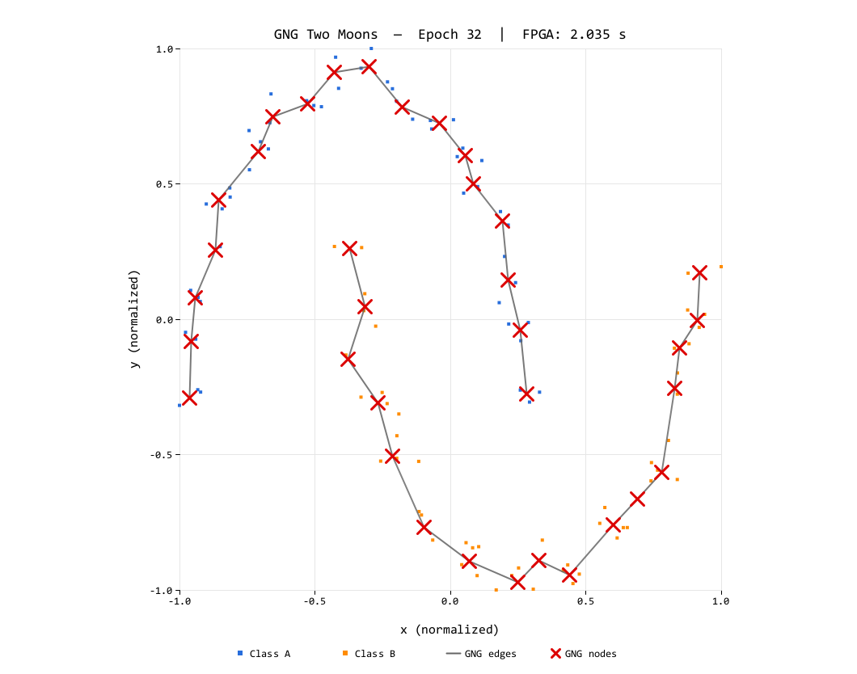
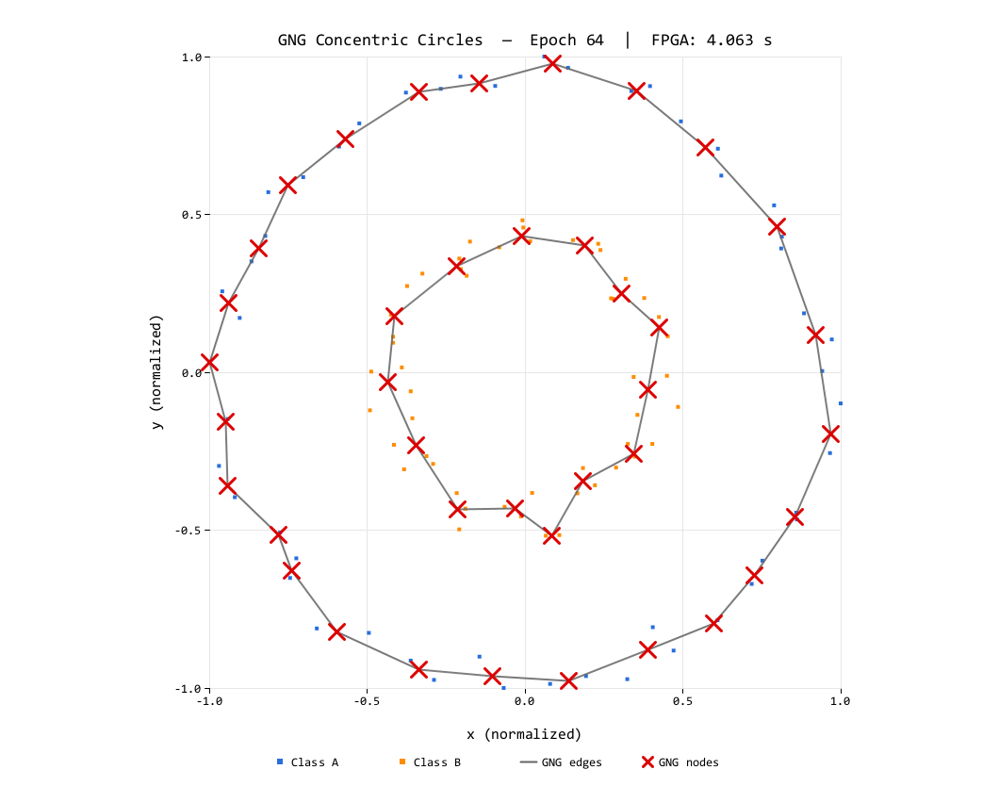
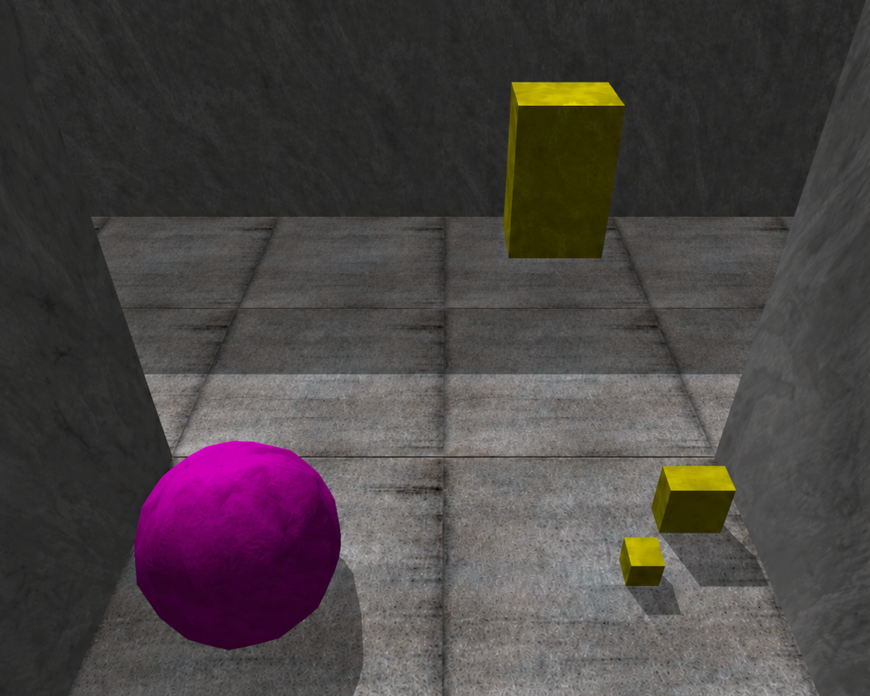
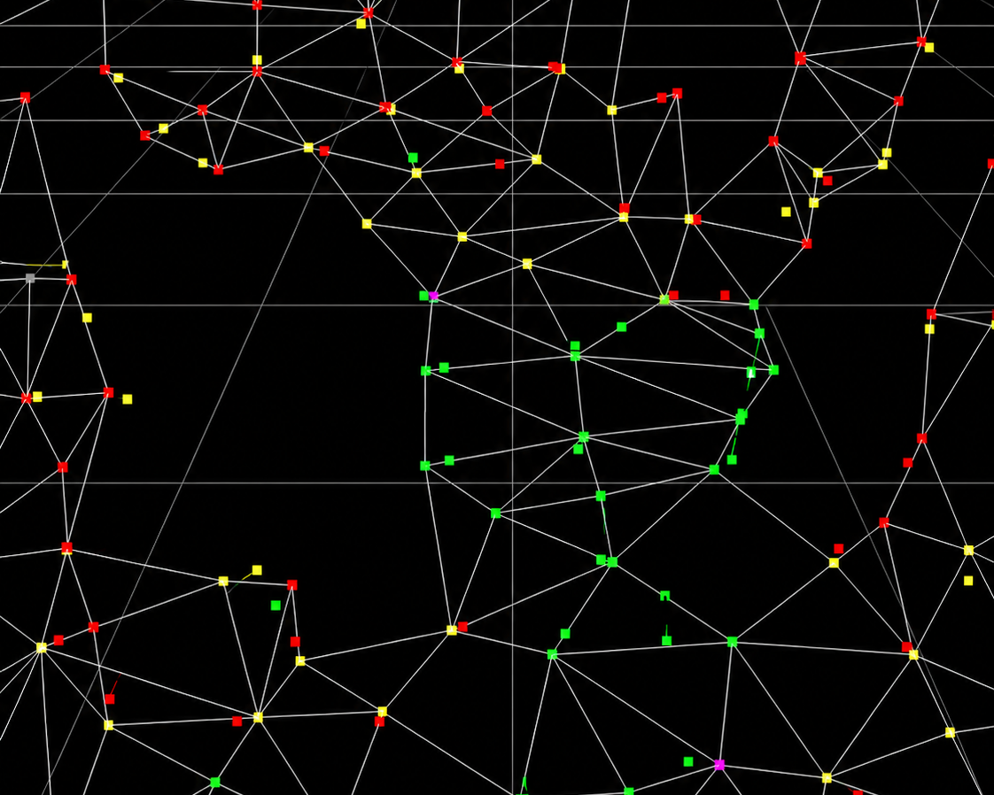
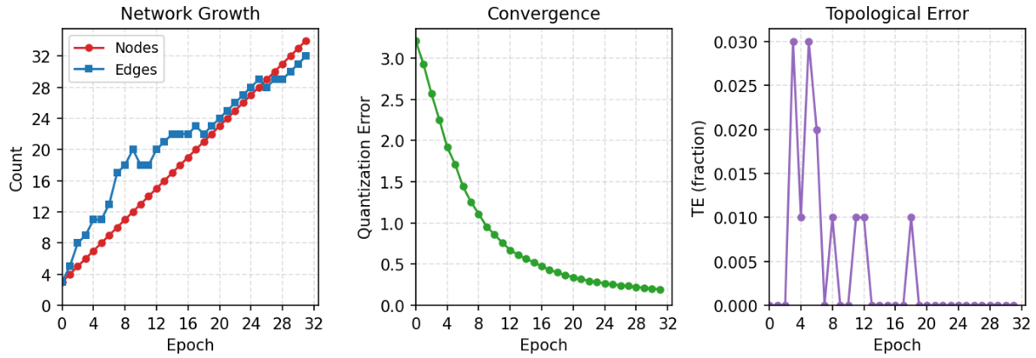
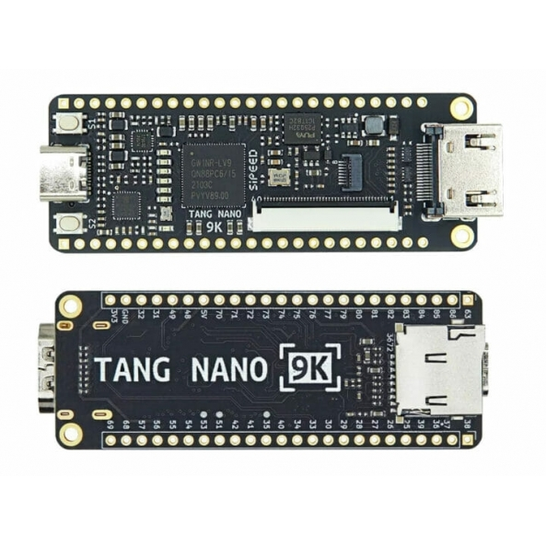
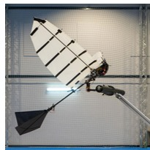
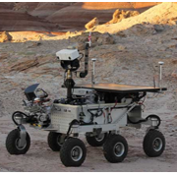
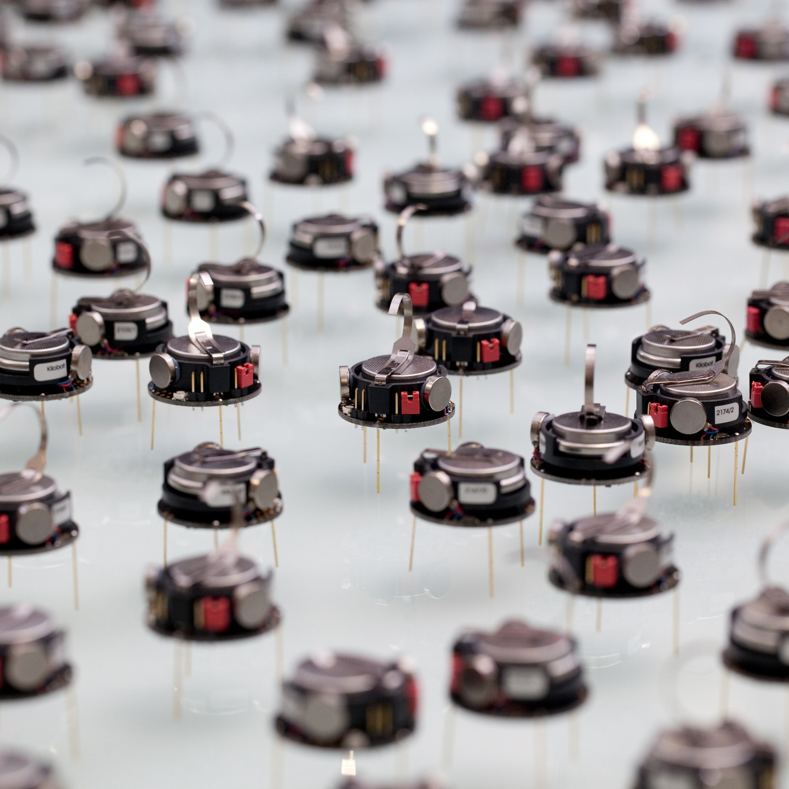
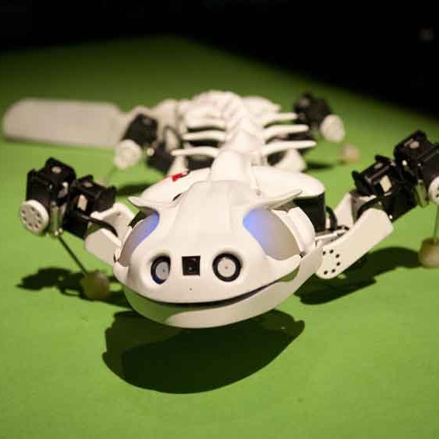
IEEE WCCI 2026 · MAASTRICHT, NETHERLANDS · 21–26 JUNE 2026 · POSTER SESSION
Edge-Cell Graph Encoding and Fixed-Point Arithmetic for FPGA Growing Neural Gas
Bringing unsupervised learning down to the embedded level
Teuku Zikri Fatahillah¹ · Raditya Artha Rochmanto^{1,2} · Achmad Fahrul Aji^{1,2}
Anhar Risnumawan^{1,3} · Chyan Zheng Siow^{1,4} · Naoyuki Kubota¹
CODE & DATA
¹ Tokyo Metropolitan University, Japan · ² Politeknik Negeri Semarang, Indonesia
github.com/tzf230201/fpga_gng
−41%
³ Politeknik Elektronika Negeri Surabaya, Indonesia · ⁴ Changsha Cultural and Creative Arts Vocational College, China
~625 µs
38%
smaller graph-state memory (2,000 B → 1,180 B)
deterministic latency / sample (≈1,600 / s)
LUT used on a 9K FPGA — 62% headroom left
1 · Motivation & Problem
CORE METHOD
6 · Results — It Fits, and It Learns
Micro-UAV swarms and field robots need on-board unsupervised adaptation — streaming raw data to the cloud is impractical. Learning must run locally, with bounded memory and deterministic timing .
4 · Edge-Cell Encoding
38%
22%
24%
50%
Edges are undirected, so store only the upper triangle of the adjacency — one byte per node pair, coding presence and age together :
LUT · 3,205/8,640
FF · 1,408/6,693
BSRAM · 6/26
DSP · 5/10
Growing Neural Gas (GNG) learns topology incrementally, sample-by-sample, without labels — ideal for streaming data. But classic GNG clashes with small FPGAs:
Place-and-route on Gowin GW1NR-LV9QN88PC6 (Gowin EDA V1.9.12.01) — 62% LUT and 76% BRAM headroom remain for application logic.
← node i
node j →
Many deep learning systems rely on labels, pretraining, or task-specific prior knowledge. In unseen or changing environments, robots may need to discover structure directly from streaming sensory data. Unsupervised topology learning methods such as SOM and GNG can learn online without labels.
0
0
1
2
3
4
5
1
3
1
0
0
0
cell = age + 1 (stored edge)
2
0
7
0
0
cell = 0 (no edge)
FPGA
3
2
5
0
lower triangle + diagonal — never stored
4
0
1
Topologies learned on the FPGA , streamed via UART snapshots. Left: Two Moons (epoch 32). Right: Concentric Circles (epoch 64). 100 samples each, N_{max} = 40.
5
4
Topological mapping in action: a robot explores its surroundings (left) while GNG incrementally builds a graph mirroring the free-space topology (right) — applications like this need adaptation to run on the device itself: payload-, power-, and link-constrained.
Half-adjacency indexing — flatten the 2D upper triangle into one 1D array, row by row:
▸
Dense adjacency is O(N²): a 40×40 8-bit matrix = 1,600 B — it dominates the BRAM budget of a sub-10K-LUT device.
0
1
2
3
4
5
6
7
8
9
10
11
12
13
14
0,1
0,2
0,3
0,4
0,5
1,2
1,3
1,4
1,5
2,3
2,4
2,5
3,4
3,5
4,5
idx(i, j) =
i (2N_{max} − i − 1)
+ (j − i − 1)
(1,3) → cell 6
▸
Floating-point needs FPU blocks or slow iterative units — integer-only datapaths map cleanly to LUTs and DSPs.
2
Implementation
Node
Edge
Total
Two Moons (final)
Concentric Circles (final)
▸
Prior FPGA self-organizing work targets SOMs with static lattices — GNG's per-iteration edge insert/age/prune on a variable graph is the hard part.
Dense adjacency (baseline)
400 B
1,600 B
2,000 B
QE 0.146 · TE 0.01
QE 0.196 · TE 0.07
Edge-cells (proposed)
400 B
780 B
1,180 B
QE (quantization error) drops steadily on both datasets and TE (topological error) stays near zero — the integer engine matches floating-point GNG quality. TE drifts slightly on Circles only after N _{max} saturates.
2 · Method Overview
−51.25% edge storage · −41% total graph state at N_{max} = 40 — freeing BRAM for application logic.
A fully integer, single-FSM GNG engine in synthesizable VHDL on the Sipeed Tang Nano 9K (Gowin GW1NR-9C) — no soft-core CPU, no FPU, no PLL.
5 · Fixed-Point Arithmetic
7 · Deterministic Real-Time Throughput
Integer-only datapath —
No floating-point unit. The whole engine runs on a Tang Nano 9K @ 27 MHz
(single FSM, 3 BRAMs, UART 1 Mbit/s).
~625 µs
~16.9k
~1,600
i
Fused NB_SCAN pass - error decay, edge aging, neighbor movement, and pruning in one sequential sweep.
per sample
cycles @ 27 MHz
samples / s
Edge-cell encoding - upper-triangular half-adjacency with 8-bit age+1 cells: 780 B vs 1,600 B edge storage.
Measured from an on-chip 32-bit cycle counter embedded in every debug frame — Two Moons: 16,852 cycles (624.1 µs); Circles: 16,931 cycles (627.1 µs). Latency is dominated by the two O(N _{max}) BRAM scans — bounded and near-identical across datasets .
ii
Tang Nano 9K · GW1NR-9C
iii
Shift-based Q8/Q16 learning rates - every adaptation step is one multiply + shift, single DSP cycle.
Coordinate representation — 16-bit signed integers in [−1000, 1000] after min-max normalization:
8 · Takeaway & Future Work
iv
Per-node degree counters - O(Nmax) isolated-node detection without scanning the edge array.
x_{norm} =
(
x − x_{min}
)
· 2s − s ,
s = 1000
Self-organizing clustering with dynamic topology is feasible on a sub-10K-LUT FPGA - relevant for robots and embedded devices with strict power, weight, physical-size, compute, and memory limits. Bounded state + incremental updates make this a hardware substrate for continual learning at the edge.
x_{max} − x_{min}
3 · GNG Loop
80-bit node word — one BRAM entry per node:
x [16]
y [16]
deg [8]
err [32]
①
Find winner s1 = argmin_i ||xi - w_i||^2 and runner-up s2.
Squared-distance unit — maps directly onto a 9×9 DSP multiplier, overflow-free:
②
UPDATE: accumulate err_s1, decay winner error, move s1 by eps_w.
Δx = ξ_{x} − x_{n} , Δy = ξ_{y} − y_{n} 17-bit signed
Lightweight flapping robots - topology mapping under tight payload and compute budgets
Low-power long missions - exploration robots adapt without high-power processors
③
NB_SCAN: decay err_n and probe edge_cell[idx(s1,n)].
d² = Δx² + Δy² 35-bit unsigned
④
If active: age/prune edge and move neighbor by eps_n.
Parametric learning rates — one multiply + shift each (single DSP cycle):
Swarm intelligence - many small robots learn with limited communication
Bio-inspired constraints - compact bodies, actuators, and RAM budgets
⑤
CONNECT resets (s1,s2) age; every lambda samples INSERT splits the max-error edge.
Winner (Q8)
Δx
s₁
= ⌊
77 (ξ_{x} − x_{s₁})
⌋
ε_{w} ≈ 0.301
2⁸
PROSPECTIVE APPLICATIONS
Neighbor (Q16)
Δx
n
= ⌊
66 (ξ_{x} − x_{n})
⌋
ε_{n} ≈ 0.001
Sample input ξ
SAMPLE
2¹⁶
↓
Multiplierless error decay
err −= err ≫ 8
no multiplier (β ≈ 0.9961)
Find winner s₁, runner-up s₂
WIN_SCAN
Fused update: UPDATE handles winner error/move; NB_SCAN fuses node-error decay, edge aging, neighbor move, and pruning in one scan - regular per-edge ops, path to FPGA parallelism.
↓
UPDATE THEN FUSED NB_SCAN
Update winner err
Move s1 by eps_w
Parameter
Value
Hardware mapping
Decay err_n + probe edge
Age/prune + move neighbor
Nₘₐₓ (max nodes)
40
node BRAM depth
Lightweight flapping robot
EPFL / R. Zufferey
Long-term exploration robot
Canadian Space Agency
NB_SCAN fuses per-node/edge ops -> path to wider FPGA parallelism
Aₘₐₓ (max edge age)
50
A_MAX_STORED = 51
↓
λ (insertion period)
100
lambda_cnt counter
Connect (s1, s2) - reset edge age
CONNECT
εw (winner lr)
≈ 0.301
EPS_WIN_Q8 = 77, ≫ 8
↓
εn (neighbor lr)
≈ 0.001
EPS_N_Q16 = 66, ≫ 16
Insert node @ lambda - split max-error edge
INSERT
α (error split)
0.5
INS_ALPHA_SHIFT = 1
↻ repeat until termination
β (error decay)
≈ 0.9961
ERR_DECAY_SHIFT = 8
Each BRAM read-modify-write takes at least 3 cycles - deterministic, bounded per-sample latency.
ERR_SHIFT (acc. scale)
4
d² ≫ 4 before accum.
Swarm robot (Kilobot)
M. Rubenstein / Science-AAAS; Harvard SEAS
Bio-inspired robot (Pleurobot)
H. Sanctuary & BioRob
Selected References
[2] T. Kohonen, “Self-organized formation of topologically correct feature maps,” Biol. Cybern. , 1982.
[8] J. Holmström, “Growing neural gas with utility,” Neural Networks, 2002.
[1] B. Fritzke, “A growing neural gas network learns topologies,” NeurIPS, 1994.
[16] P. Coelho et al., “FPGA implementation of self-organizing maps using fixed-point arithmetic,” J. Signal Process. Syst. , 2020.
[25] Piyasena et al., dynamically growing SO network (GWR-like) on FPGA for lifelong learning at the edge.
[26] Firmli et al., compressed sparse row (CSR++) for low-degree-graph memory reduction.
Supported by the Japan Science and Technology Agency (JST), Moonshot R&D Program, grant JPMJMS2034.
[email protected]

